Slide 1
BUILDING CONSTRUCTION I LECTURE 3 FOUNDATION

Slide 2
FOUNDATIONS
Definitions
Foundation is the part of a structure that is usually placed below the surface to transmit the load from the superstructure to the underlying soil or rock.
Footings are those parts of the foundation which resting directly on the soil, support specific portion of building and distributing building loads directly to the soil.

Slide 3
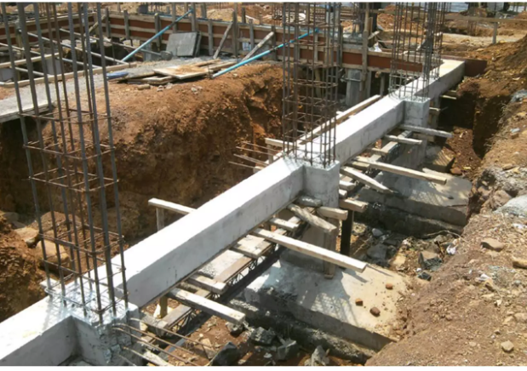
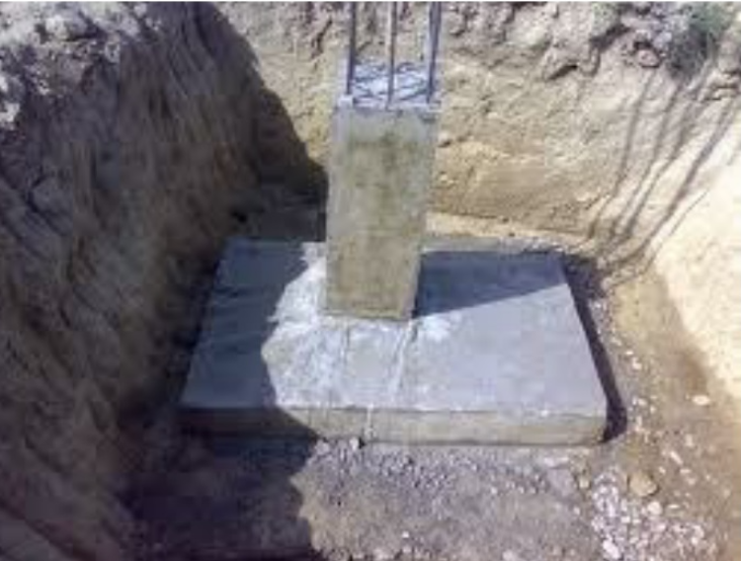

Slide 4
Foundation is used to transmit the weight of the structure (live, dead and pressure) to the materials on which the structures rest in such a manner that the underlying materials are not stressed beyond its safe bearing capacity.
The foundation are usually placed below the ground level because the surrounding provides;
Stability
Protection against impact
Protection against extreme of weather such as excessive rain or draught. Though the depth vary according to conditions on site, most of load bearing ground is normally 900mm below the surface.

Slide 5
Foundations function ~ the function of any foundation is to safely sustain and transmit to the ground on which it rests the combined dead, imposed and wind loads in such a manner as not to cause any settlement or other movement which would impair the stability or cause damage to any part of the building.
Foundation Materials ~ one of the functions of a foundation can be seen to be the ability to spread its load evenly over the ground on which it rests. It must of course be constructed of a durable material of adequate strength. The most suitable material is concrete.

Slide 6
Settlement: the load carried by foundations naturally cause settlement. If settlement is light and evenly distributed, no damage is done to the building. but if it is extensive and unequally distributed, it may result in failure of the foundation, cracked walls, distorted doors and window openings, as the result the building may collapse.
Requirement of Good Foundation
Location:
The foundation should be located in such a way that it is capable to resist any unexpected effect which may adversely affect performance of the structure.
Eg. Trees ~ damage to foundations. Sub-structural damage to buildings can occur with direct physical contact by tree roots.

Slide 7
Stability:
Foundation should be safe and stable against all possible forces to which the structure likely to be subjected Underground defects
Settlement:
Settlement of the structure should be within permisible limit
Factors affecting the selection of foundations
Types and intensity of loads acting on various parts of the structure which may be dead load, live load, wind load, snow load, etc.
Nature and bearing capacity of the soil on which the structure directly rests.

Slide 8
3. The position (depth wise) of the suitable load bearing soil.
4. The level of water table
5. The total weight of the building.
Depth and location of foundation depends on the following
Zone of significant volume changes in soil.
Adjacent structures and property lines.
Ground water
Underground defects

Slide 9
Zone of significant volume changes in soil
Clays having high plasticity shrink and swell considerably up on drying and wetting respectively.
Volume change is greatest near ground. Decreases with increasing depth. Volume changes usually insignificant below a depth from 1.5-3.0 m
Adjacent structures and property lines.
The structures may be damaged by the construction of new foundations:
Effect of vibrations, undermining by excavation or lowering of water table

Slide 10
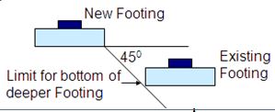
The load placed on the soil may cause settlement of the previous structures as the result of new stress pattern in the surrounding soil
In general, deeper the foundations and closer to the old structures, greater will be the potential for damage to old structures

Slide 11
Ground water
Presence of water reduces soil bearing capacity, larger footing size more cost. During construction pumping is necessary – adds to the cost of construction.
Underground defects
Footing location affected by underground defects
Faults, caves, mines, sewer lines , underground cables and utilities

Slide 12
Precaution on foundations design
It is expensive and difficult to repair
Usually it is constructed under the ground, so it is out of sight
Bad foundation could demolish the building
Types of foundations
Foundations can be considered under two groups:
shallow foundations.
Deep foundations.

Slide 13
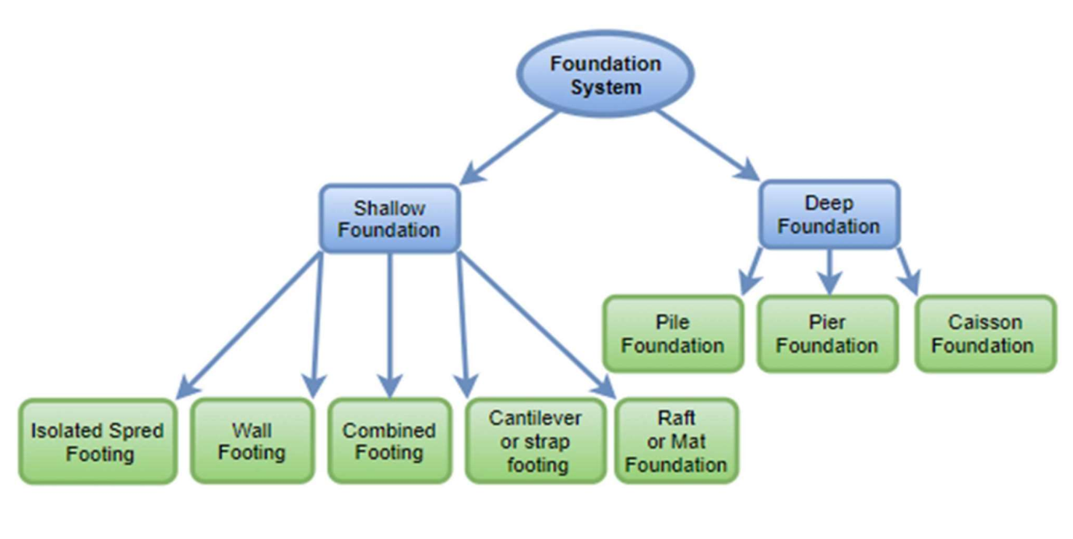
Types of foundation cont..

Slide 14
Shallow foundations
Are usually located no more than 3m below the lowest finished floor.(D>B)
A shallow foundation system generally used when
The soil close to the ground surface has sufficient bearing capacity, and
Underlying weaker strata do not result in excessive settlement.

Slide 15
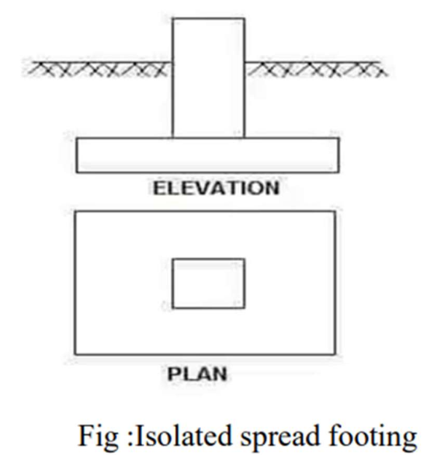
Types of shallow foundations
Pad/isolated spread footings
The foundation which is provided under single column is called as isolated footing.
Suitable for most sub-soils except loose sands, loose gravels and filled areas. Pad foundations are usually constructed of reinforced concrete and where possible are square, rectangular or circular in plan.

Slide 16
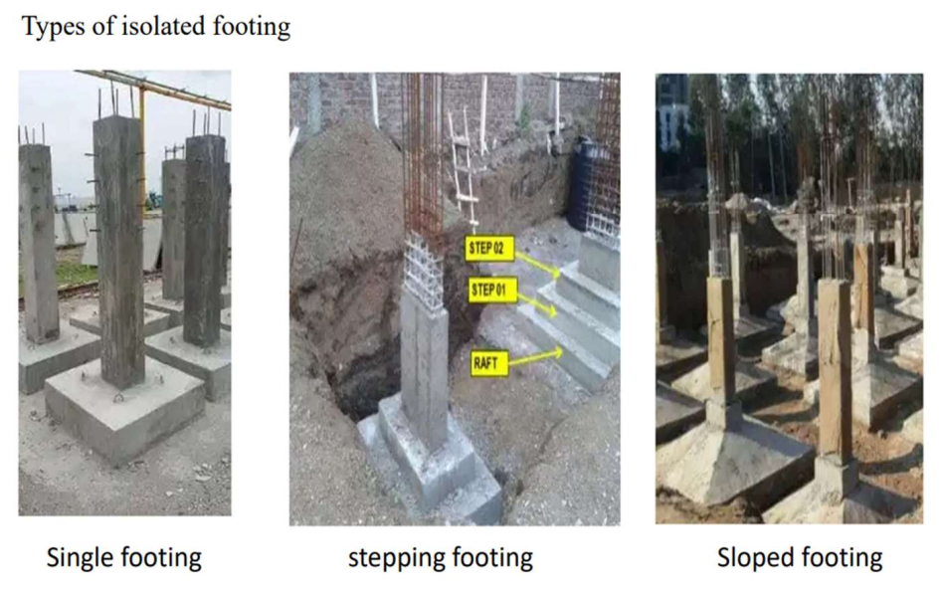
Types of shallow foundations CONT…

Slide 17
Construction Process of Pad/isolated footing
Constructing footings involves several steps:
Excavation: A trench is dug according to specified dimensions.
Formwork Installation: Forms may be created using wood or other materials to shape the concrete.
Reinforcement Placement: Steel rebar is added for strength.
Concrete Pouring: Concrete is poured into the forms and allowed to cure properly.

Slide 18
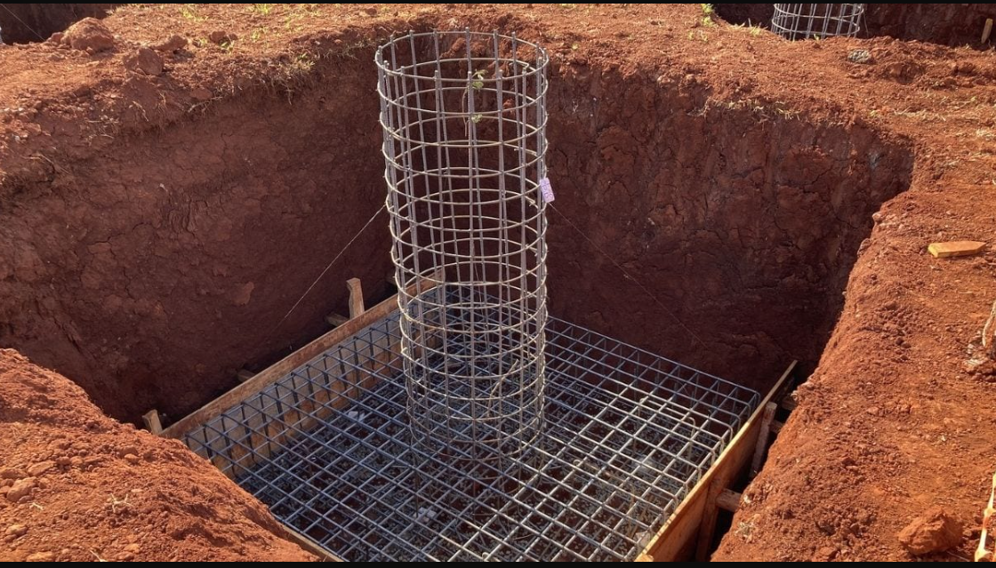
Construction Process of Pad/isolated footing

Slide 19
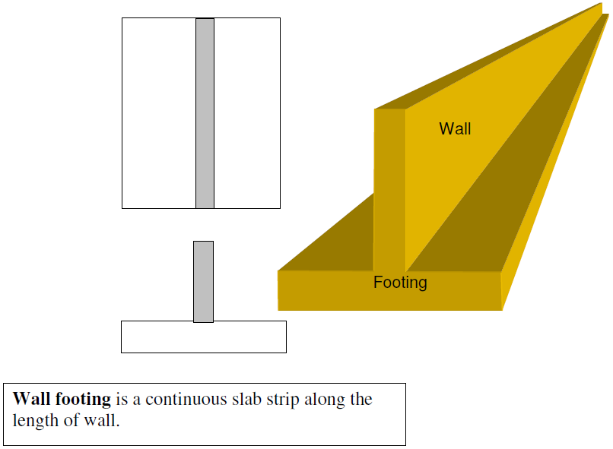
Types of shallow foundations CONT…
Wall Footing (Strip Foundation): The footing which is provided to support wall is known as strip foundation. These footing have length much greater than its width(L>>B)

Slide 20
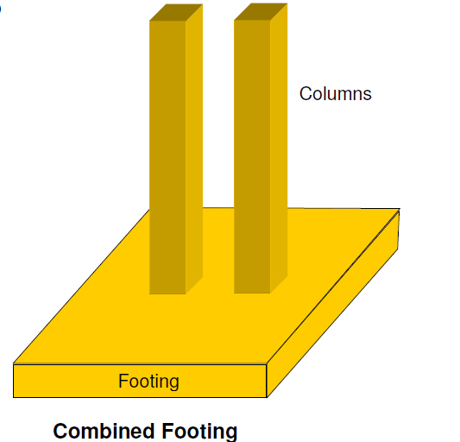
Types of shallow foundations CONT…
Combine Footing: Combine footing is provided to support two or more column in a row. It is provided when two or more column is too close.

Slide 21
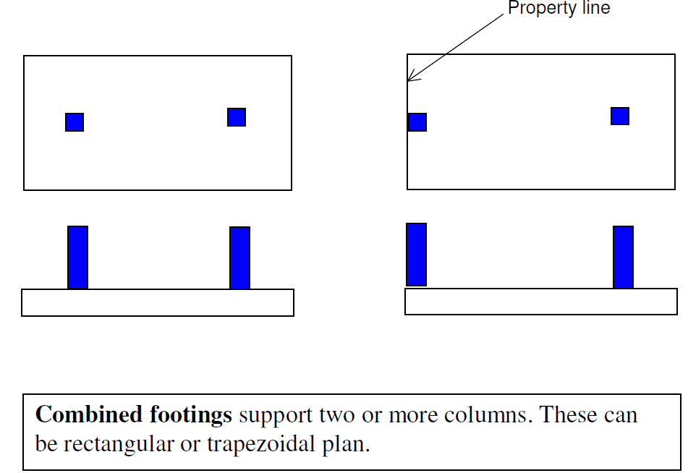
Combined footings

Slide 22
types of shallow foundations cont…
Strap Footing( Cantilever footing):
A foundation which consists of two or more isolated foundation connected by a beam is called strap foundation.

Slide 23
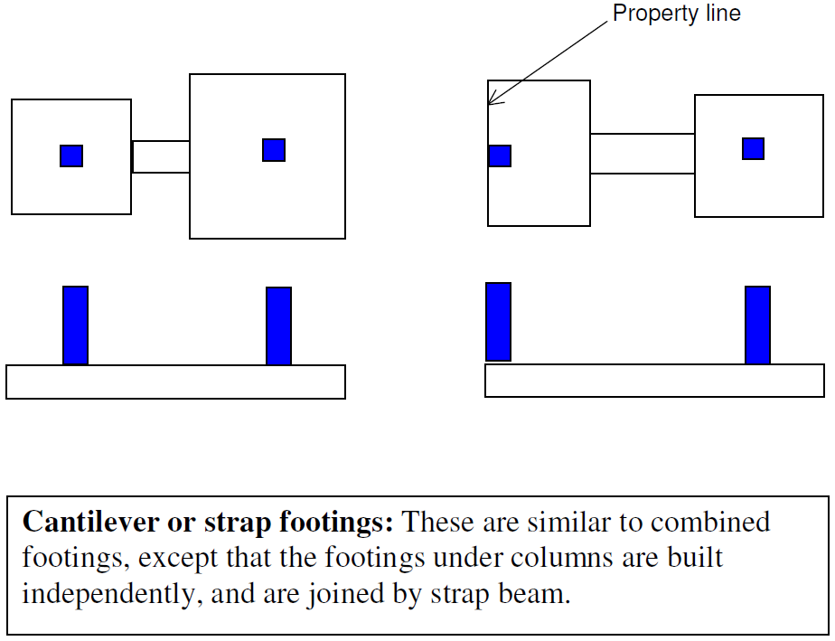
Cantilever or Strap footings

Slide 24
Types of shallow foundations CONT…
Raft or Mat foundation: Raft or mat foundation is a large foundation or slabs supporting several columns as well as wall under structure.
This type of foundation is used when the allowable soil pressure is low or where the columns and wall are so close that individual foundation would overlap or nearly touch each other.

Slide 25
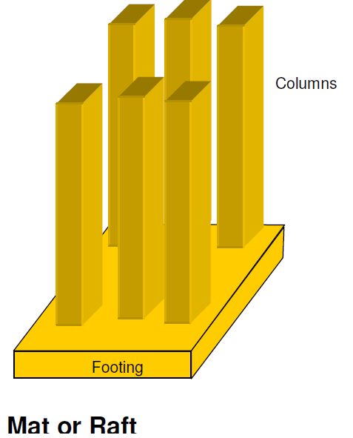
Mat/raft Foundation

Slide 26
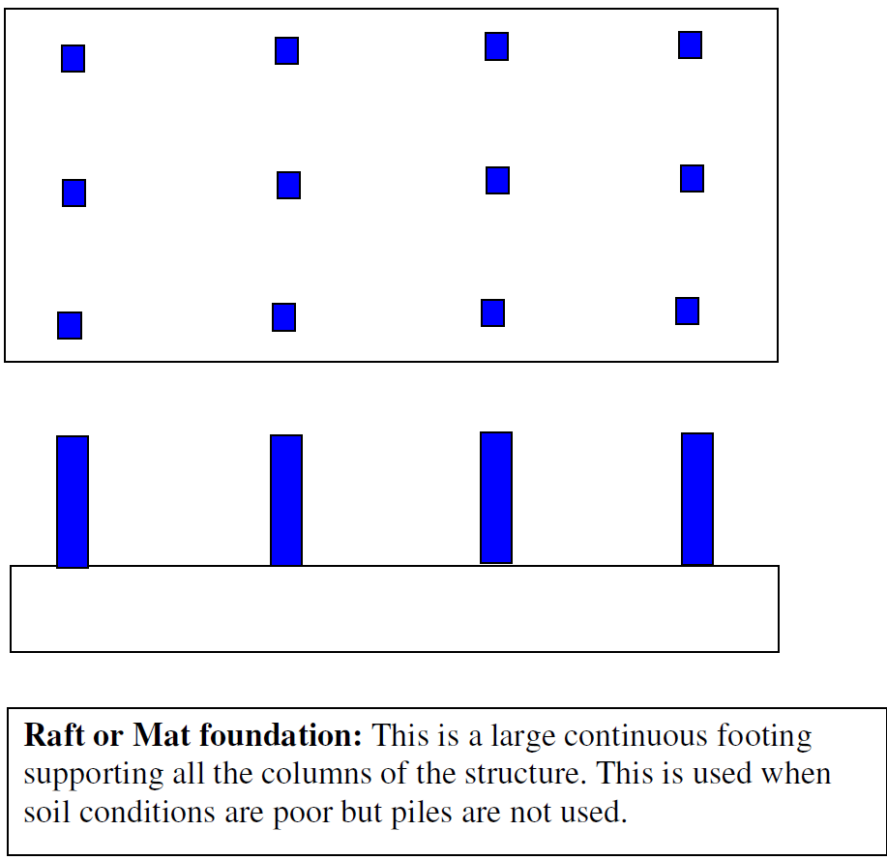

Slide 27
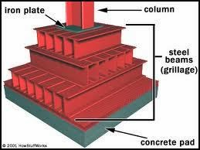
Steel Beam – Foundation Grillage
Grillage foundations are a specialized type of shallow foundation designed to efficiently distribute loads from structures over a larger area, particularly useful in conditions where soil bearing capacity is low. This foundation system typically consists of multiple tiers of beams, either made of steel or timber, arranged at right angles to each other and placed on a concrete layer.

Slide 28
Deep foundations
Deep foundation is required to carry loads from a structure through weak compressible soils or fills on to stronger and less compressible soils.
Deep foundations are founded too deeply below the finished ground surface for their base bearing capacity to be affected by surface conditions, this is usually at depths >3 m below finished ground level.

Slide 29
Types of Deep foundations
1. Pile Foundations
Piles are long, slender columns driven into the ground to transfer loads to deeper soil layers. They can be made from various materials, including wood, concrete, and steel.
Types of pile foundations
End Bearing Piles: Transfer load through the tip of the pile resting on a strong soil layer.
Friction Piles: Distribute load along the length of the pile through friction with surrounding soil.
Combination Piles: Utilize both end bearing and friction methods

Slide 30
Types of Deep foundations Cont..
Pile foundations are used in the following situations:
When there is a layer of weak soil at the surface. This layer cannot support the weight of the building, so the loads of the building have to bypass this layer and be transferred to the layer of stronger soil or rock that is below the weak layer.
When a building has very heavy, concentrated loads, such as in a high rise structures.

Slide 31
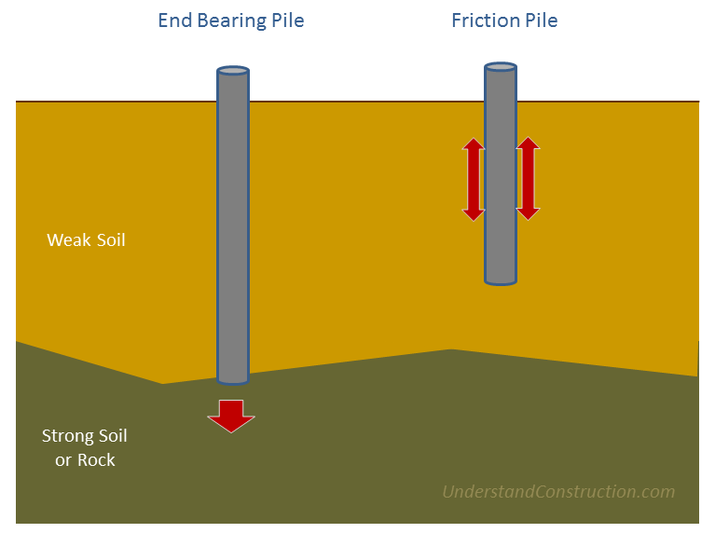
Types of Deep foundations Cont..

Slide 32
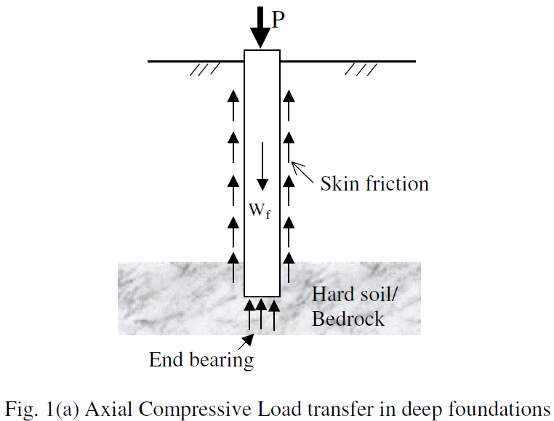

Slide 33
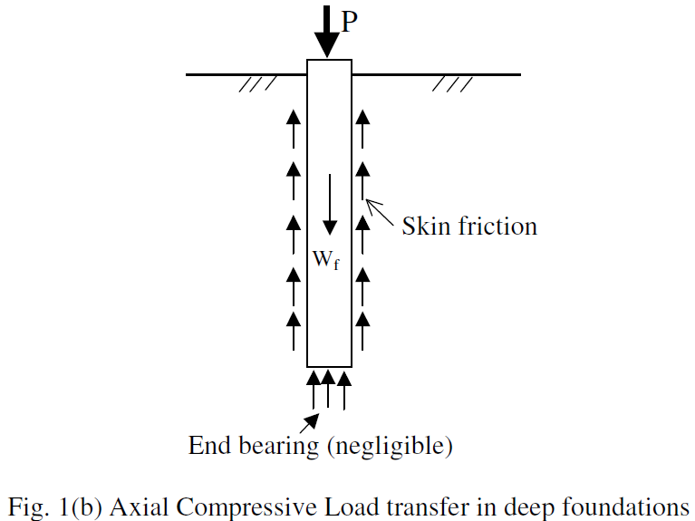

Slide 34
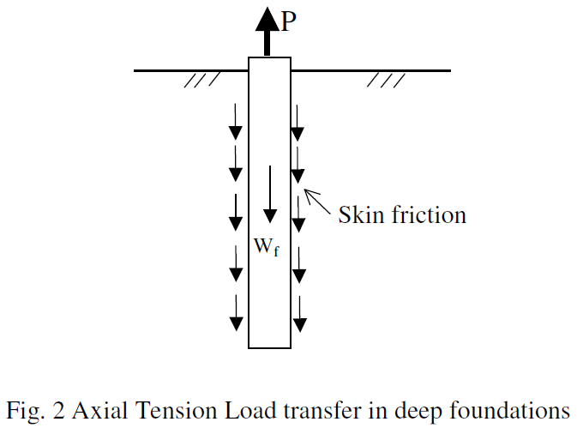

Slide 35
Types of Deep foundations Cont…
2. Caisson Foundations
Caissons are large, hollow structures that are sunk into the ground and filled with concrete. They are often used in water bodies for bridges or piers.
Types of Caisson foundations:
Open Caissons: Open at the bottom and filled with concrete after being sunk.
Pneumatic Caissons: Used in underwater construction, requiring air pressure to keep water out during placement.
Box Caissons: Prefabricated boxes that are floated to site and sunk into position

Slide 36
Types of Deep foundations Cont…
3. Drilled Shaft Foundations
Also known as drilled piers, these foundations involve drilling a hole into the ground, placing reinforcement, and then pouring concrete. They provide high load capacity and stability.
Ideal for heavy structures where high load-bearing capacity is required
4. Basement Foundations
Basements serve as both living space and foundation. They must be designed to withstand soil pressure and moisture.
Useful in residential buildings where additional space is needed below ground level.

Slide 37
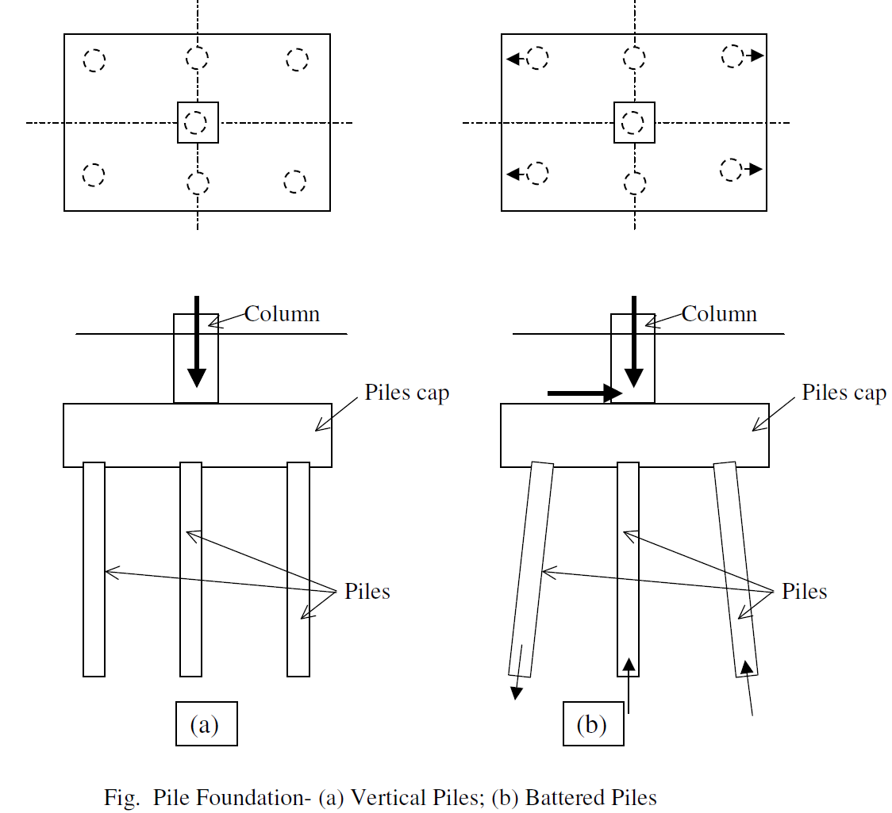
Pile foundation cont...

Slide 38
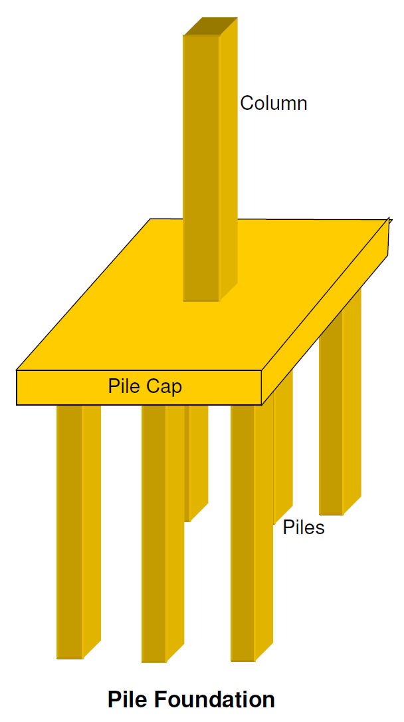
Pile foundation cont...

Slide 39
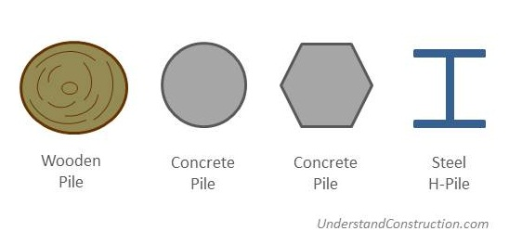
Piles can be made of wood, concrete, or steel.

Slide 40
EARTH WORK ON FOUNDATION
Setting out of Foundation
Setting out of building foundation trenches is the process of laying down the excavation line and centerline on the ground based on the foundation plan.
The setting out process is also called as ground tracing that is performed before commencing the excavation process. Once the design of foundation is complete, a setting out plan or foundation layout is prepared for a suitable scale and the plan is dimensioned accordingly ( ref. building setting out procedures)

Slide 41
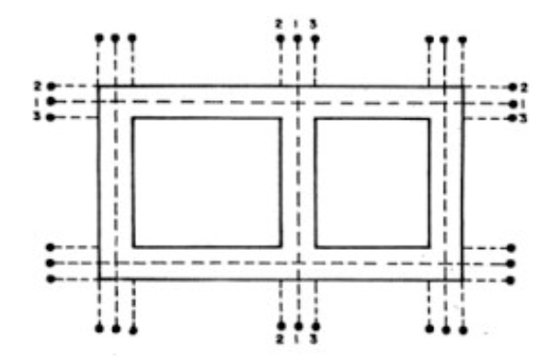
EARTH WORK ON FOUNDATION CONT..

Slide 42
EARTH WORK ON FOUNDATION CONT…
Timbering of Trenches
- Timbering of trenches is a construction technique used to provide temporary support to the sides of excavated trenches. -This is When the depth of trench is large, or when the sub-soil is loose, the sides of the trench may cave in.
-The problem can be solved by adopting a suitable method of timbering.
-Timbering of trenches, sometimes also known as shoring consists of providing timber planks or boards and struts to give temporary support to the sides of the trench.

Slide 43
EARTH WORK ON FOUNDATION CONT…
Method of Timbering of trenches
Timbering of deep trenches can be done with the help of the following methods:
1. Stay bracing: This method is used for supporting the sides or a bench excavated in firm soil when the depth of excavation does not exceed about 2m.
The method consists of placing vertical sheets (called sheathing) or polling boards opposite each other against the two walls of the trench and holding them in position by one or two rows of struts.
The sheets are placed at an interval of 2 to 4m

Slide 44
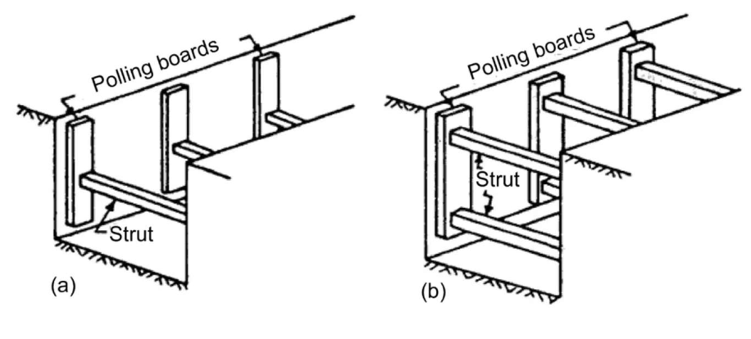
Method of Timbering of trenches CONT..
Stay bracing:

Slide 45
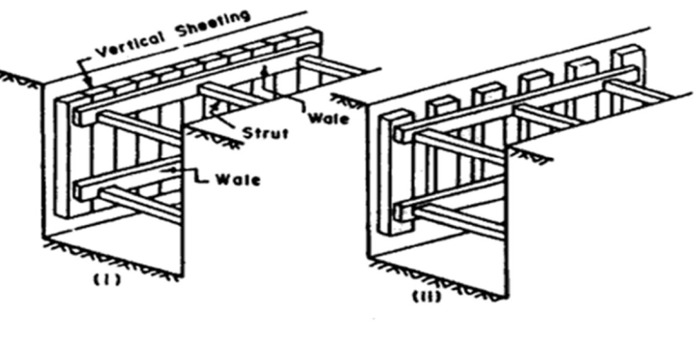
Method of Timbering of trenches CONT..
2. Box sheeting: This method is adopted in loose soils when the depth of excavation does not exceed 4m. A box like structure is made using sheeting, Wales, struts, and bracings. The vertical sheets placed near to each other and keeping them in position by longitudinal rows (usually two) of Wales. Struts are then provided across the Wales.

Slide 46
Method of Timbering of trenches CONT..
3. Vertical Sheeting
This system is adopted for deep trenches (up to 10 m depth) in soft ground. The method is like the box sheeting except that the excavation is carried out in stages and at the end of each stage, an offset is provided, so that the width of the trench goes on decreasing as the depth increases. Each stage is limited to about 3 m in height and the offset may vary from 25 to 50 cm per stage.

Slide 47
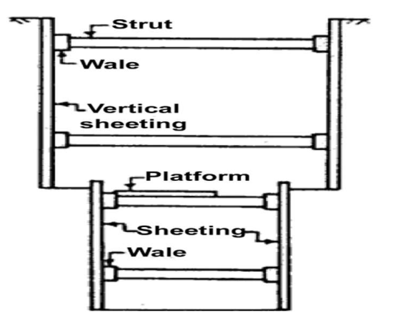
Method of Timbering of trenches CONT..
Vertical Sheeting

Slide 48
Method of Timbering of trenches CONT..
4. Runner System
This system is used in extremely loose and soft ground, which needs immediate support as excavation progresses.
The system is like vertical sheeting of box system, except that in the place of vertical sheeting, runners made of long thick wooden sheets or planks with iron shoe at the ends, are provided. Wales and struts are provided as usual. These runners are driven about 30 cm in advance of the progress of the work by hammering.

Slide 49
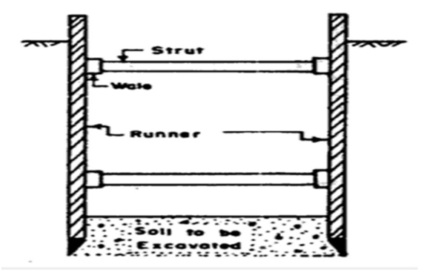
Method of Timbering of trenches CONT..
Runner system

Slide 50
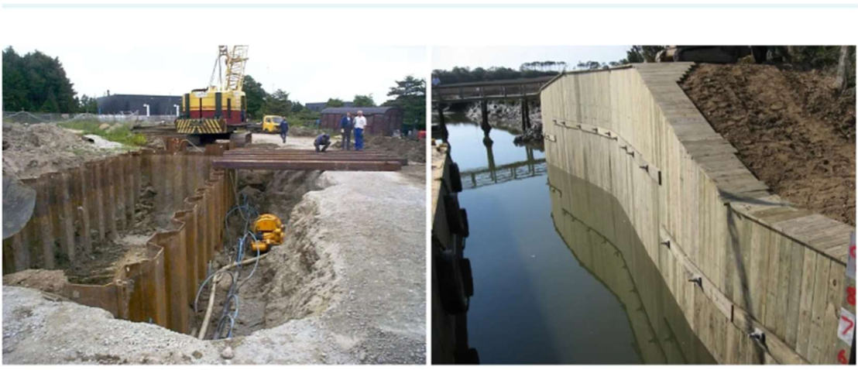
Method of Timbering of trenches CONT..
5. Sheet Pile This method is adopted when soil to be excavated is soft or loose, depth of excavation is large, width of trench is also large and Sub soil water is present.

